Slide 1


Sildenafil
Past, Present & Future
National Neonatology Forum Conference November 2023
Dr. P K Rajiv
MBBS, DCH,MD FRCPCH, FIAP , FNNF
Fellowship in Neonatology(Australia)
Ex Professor of Neonatology
Amrita Institute of Medical Sciences Kochi INDIA.
Previously Head of Newborn NMC hospital, DUBAI
President Indian Academy Pediatrics Emirates Neonatal Chapter

Slide 2
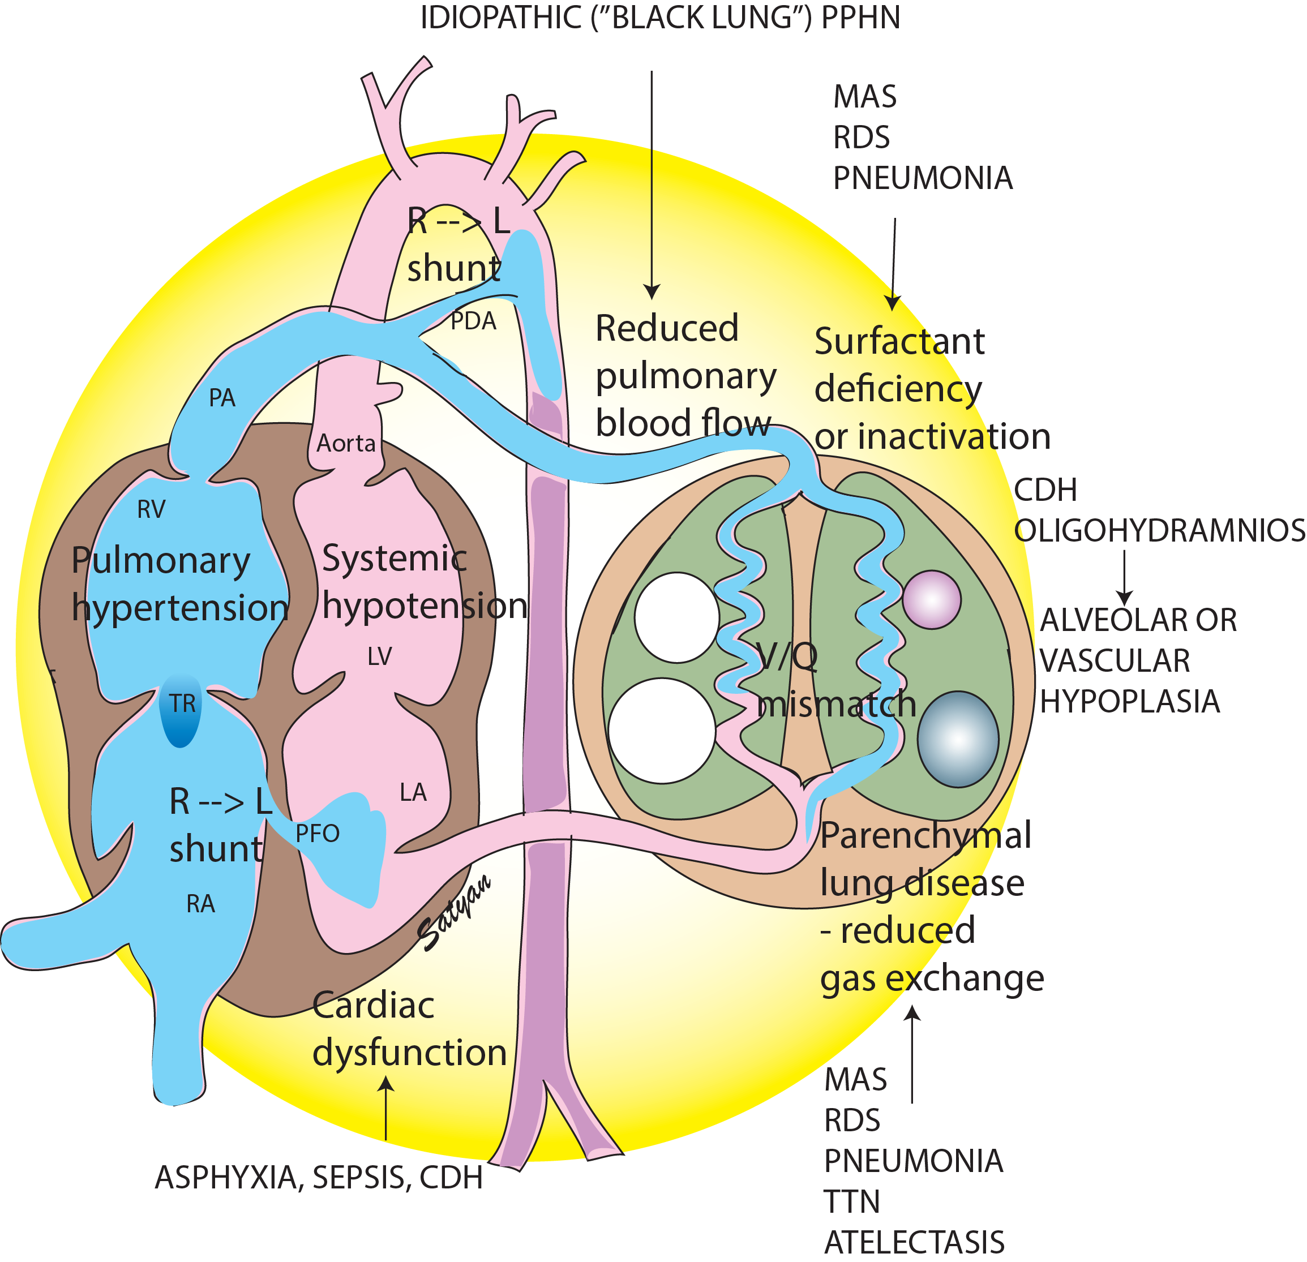
Transient Tachypnea of Newborn (TTN)
Aspiration syndromes
(meconium or blood)
Congenital Diaphragmatic Hernia (CDH)
Hyaline Membrane Disease (RDS)
Pneumonia / Sepsis
Asphyxia
PPHN
Etiology & Pathophysiology

Slide 3
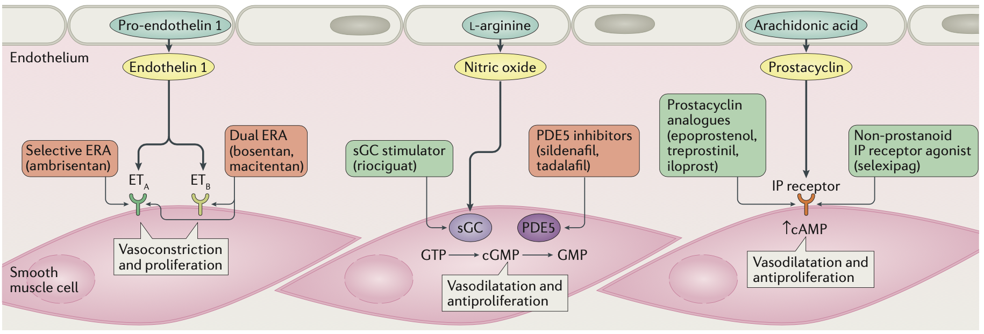
Sildenafil - PPHN
Current Perspective
Endothelin Pathway
Nitric oxide Pathway
Prostacyclin Pathway
Bosentan
NATURE REVIEWS | CARDIOLOGY ,OCT 2017

Slide 4
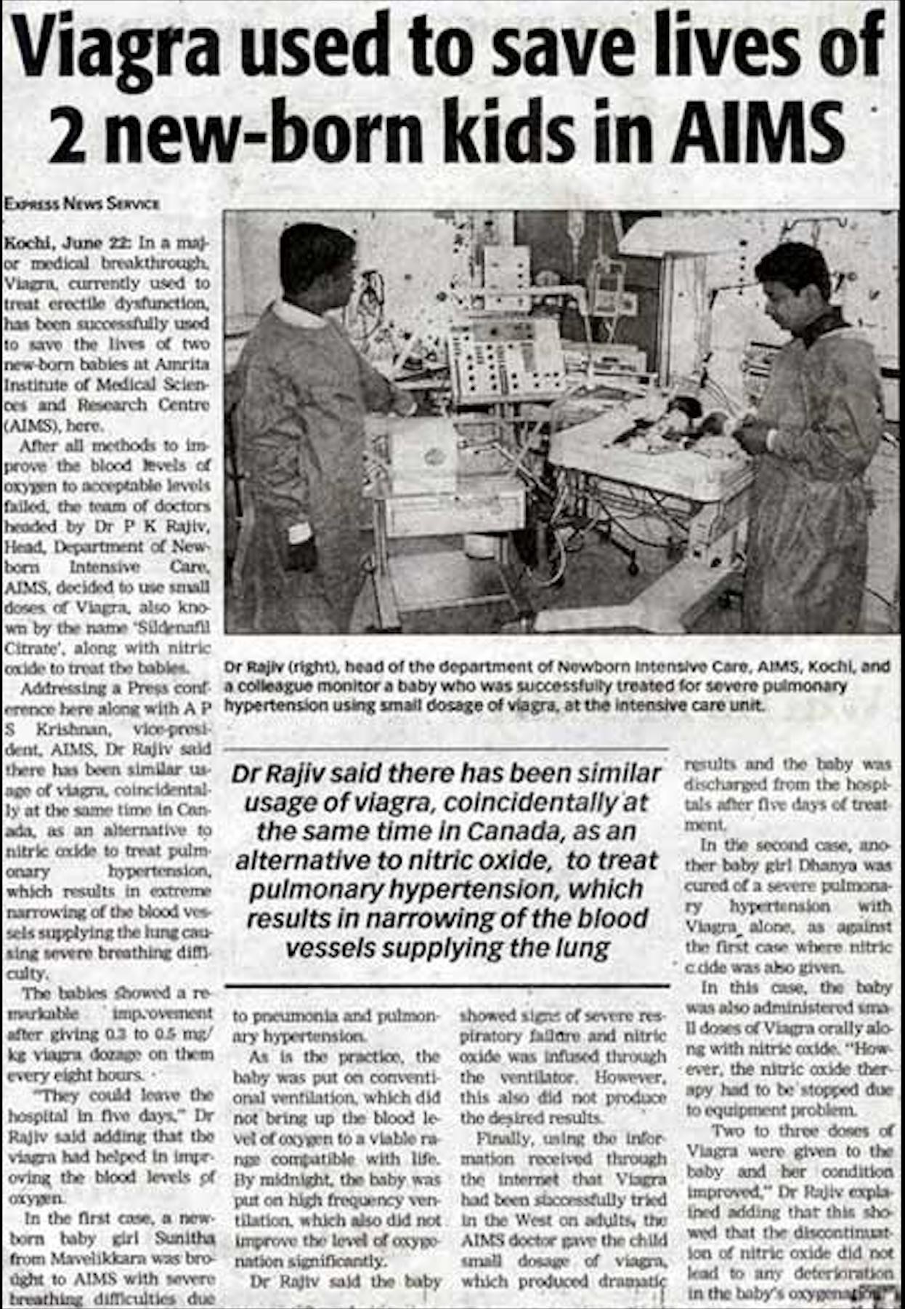
Sildenafil - 2002
AIMS-KOCHI-KERALA-INDIA
SUCCESSFUL USAGE OF SILDENAFIL TO TREAT PPHN IN 2002

Slide 5
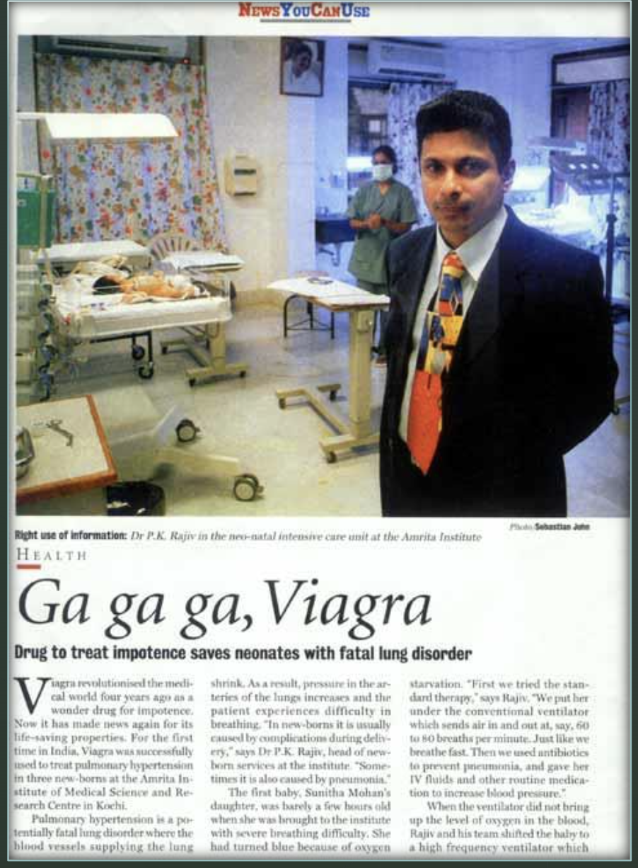
Viagra Saves Blue Babies
Ethics & Conscience
Neonatology Conference
Washington D. C. (2002)
BMJ 2002; 10.1136

Slide 6
Sildenafil the New Nitric
Literature Review
Side Effects of iNO
Drawbacks of iNO
Failure Rate – 30% to 40%
Rebound PAH – 10%
Suppresses Endogenous NO
Expensive Medical Grade Gas
Not widely Available
Need Special Training
Transport of PPHN: IV Sildenafil versus iNO

Slide 7
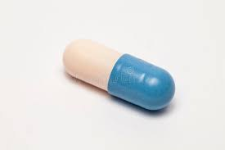
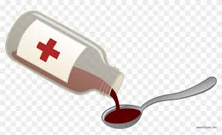
Oral Sildenafil
0.25 – 0.5 mg/kg/dose every 4 to 8 hours
Maximum dose of 2mg/kg/dose 6 hourly.
<37 Weeks Corrected Gestational Age
Loading
Maintenance
Loading: 0.13mg/kg/hour administered over 45 minutes
Maintenance :0.02 to 0.05 mg/kg/hour
> 37 Weeks Corrected Gestational Age
Loading: 0.13mg/kg/hour administered over 3 hours
Maintenance : 0.07mg/kg/hour
Intermittent
0.5 mg /kg every 8 hrs over 15-60 min

Slide 8
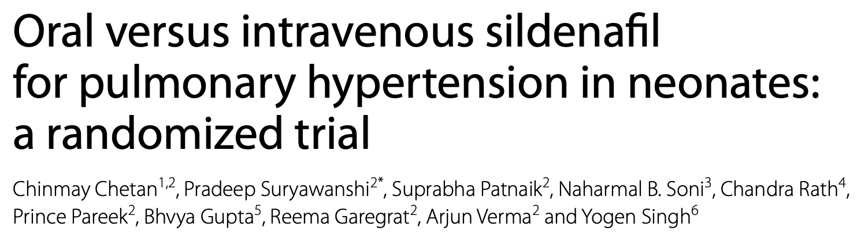
Oral
BMC pediatrics ,May,2022
Conclusion
Efficacy of sildenafil in LMICs well proven
Oral and intravenous sildenafil had equal efficacy at reducing PAP in neonatal pulmonary hypertension
Intravenous sildenafil use was associated with a greater complication rate.

Slide 9
Sildenafil for pulmonary hypertension in neonates: An updated systematic review and meta‐analysis , Pediatrics Pulmonology.April 2021.
8 studies were included with 216 term and premature neo- nates with PPHN
Compelling evidence showed the use of sildenafil could improve the prognosis of PPHN neonates,
After 24 h of treatment
OI steady decrease (SD: −1.80, 95% CI: −2.92, −0.67)
Peak effects after 72 h of treatment (SD: −4.02, 95% CI: −5.45, −2.59).
No clinically significant side effects were identified

Slide 10

Endothelin receptor antagonists for persistent pulmonary hypertension in term and late preterm infants
Bosentan
Kiran More etal.
18 August 2016
There is inadequate evidence to support the use of ETRAs either as stand-alone therapy or as adjuvant to inhaled nitric oxide in PPHN. Adequately powered RCTs are needed.
Bosentan was well tolerated but did not improve oxygenation
Steinhorn RH etal ,FUTURE-4 study. J of Pediatrics Oct 2016.
May be appropriate for PPHN with CDH, BPD

Slide 11
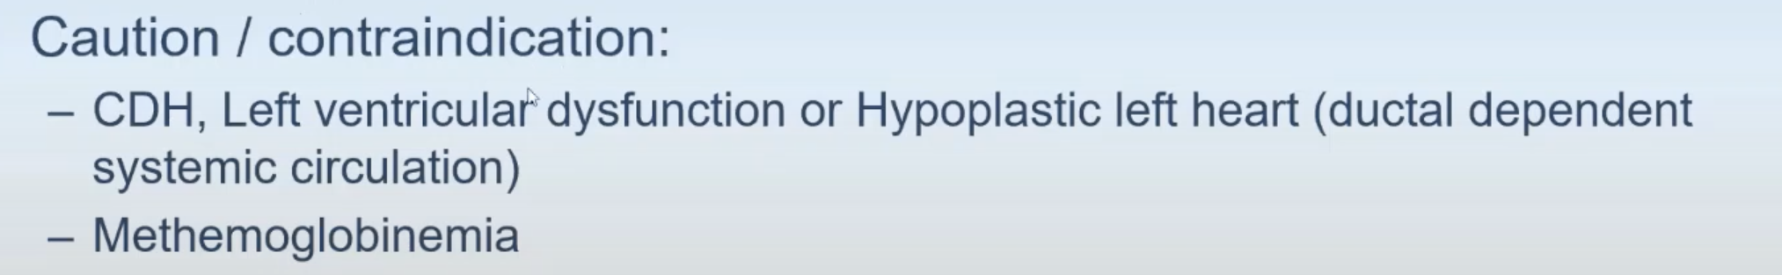
Indication for INO
PPHN and /or HRF in >34 weeks gestation infants
Oxygenation Index >25 , 15-20 in Echo evidence of PPHN
Need of >60% FIO2 to Maintain Preductal Spo2 >90%
iNO in Indicated for treatment of PPHN in mechanical ventilated Term and near term Newborn Infants to improve oxygenation and to reduce the need of ECMO:i)if PaO2 less than 100mmHg ( even after 100%FIO2) or ii)Oxygenation Index exceeds 25 ..
I
A

Slide 12
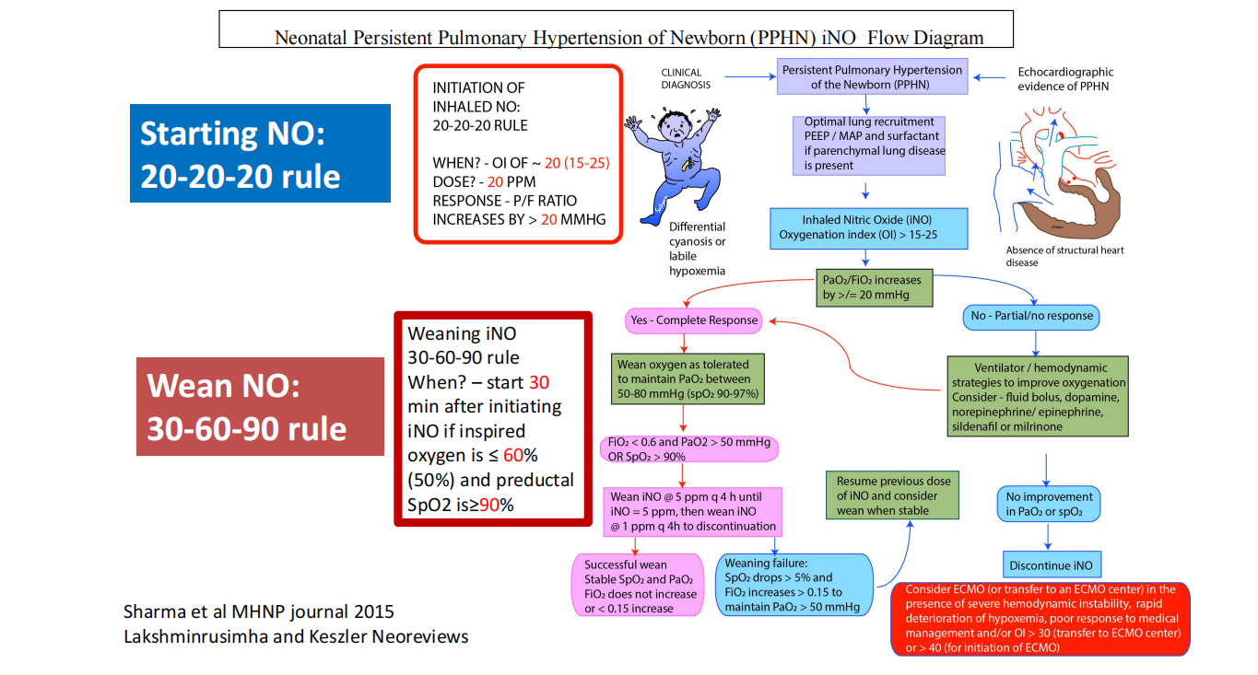

Slide 13
Oxygen saturations and PVR
90-97%
Lakshminrusimha S et al, Pediatr Res. 2009 Nov;66(5):539-44

Slide 14
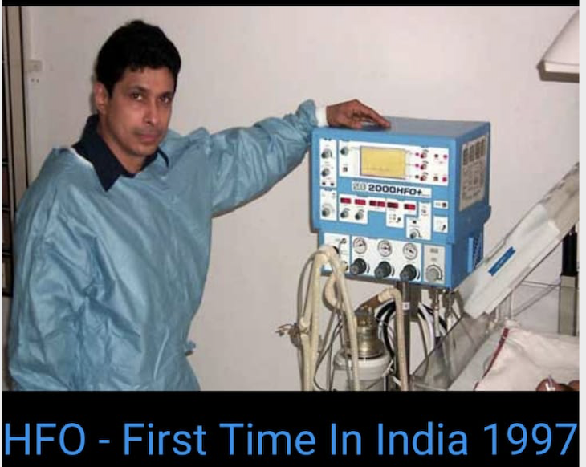
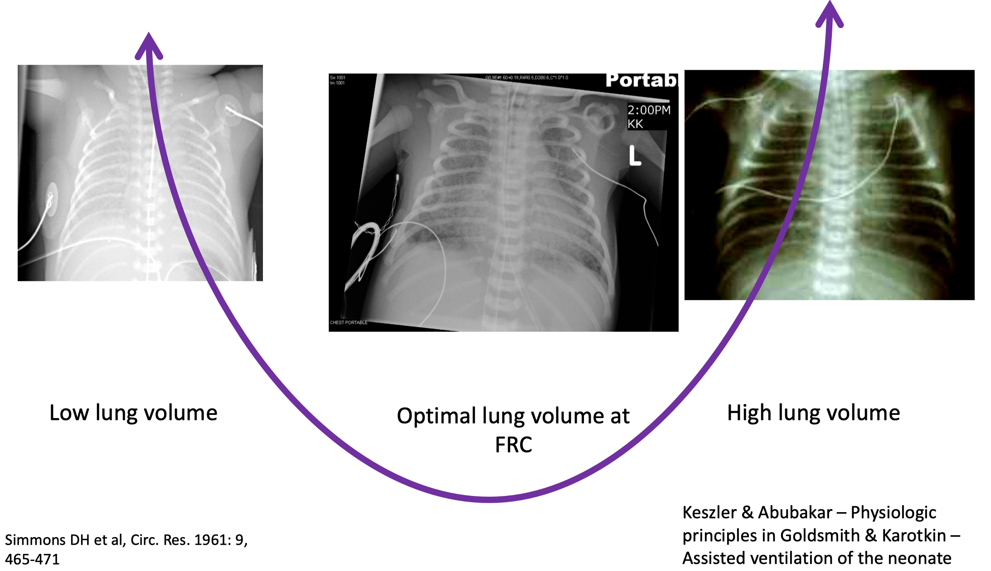
PVR Nadir at Functional Residual Capacity(FRC)
6-8 Rib spaces
Ventilation with optimal Lung Recruitment
Lakshminrusimha S et al, Pediatr Res. 2009 Nov;66(5):539-44

Slide 15

Management

Slide 16
MANAGEMENT OF PULMONARY HYPERTENSION- LMICs,> 35 weeks
OPTIMIZE CARDIOPULMONARY MECHANICS
Lung recruitment
“Gentle ventilation" strategy,
PaCO2= 45-60mmHg
2DECHO
Avoid/treat acidosis, infection
MBP <45-50
IV fluid bolus 10ml/kg
Max - 2 times
Clinical /Echo -PPHN
SILDENAFIL IV
LV function, narrow pulse pressure-
Adrenaline (0.05-0.4mic/kg/min.
If sepsis, SVR , wide pulse pressure
Nor Adrenaline((0.05-0.4mic/kg/min
Add Hydrocortisone
2DECHO
If closing Duct with RV dysfunction
IV PGE1/E2
RV /LV dysfunction – MILRIONONE (0.25-0.75mcg/kg/min).
Dobutamine if ECHO not available or hypotension
If Refractory Hypotension consider VASOPRESSIN(0.01-0.05units/kg/hour)
@ Yogen Singh

Slide 17
ECHO GUIDE
1. PFO: R→L or BD shunt
2. PDA: R→L or BD shunt
3. Ventricular septum: "flattening" / "leftward bowing"
4. Ventricular dysfunction (RV and/or LV)
5. Confirm normal anatomy,pulmonary veins
MANAGEMENT OF PULMONARY HYPERTENSION- LMICs
OPTIMIZE CARDIOPULMONARY MECHANICS
Lung recruitment/optimal MAP (HFOV)
“Gentle ventilation" strategy,
PaCO2= 45-60mmHg
Early surfactant
BP normal for age
Avoid/treat acidosis, infection
Adequate sedation/analagesia
MONITORING
Arterial line (IBP)
Pre- and post-ductal sats
OI = (MAP x FiO2)/ PaO2
OSI =(MAPx FiO2)/SPO2
TARGETS
Preductal sats: 92-97%
Mean BP: Age appropriate
Arterial pH 7.3+ while critically ill
(liberalize to 7.25 once stable)
HYPOXEMIA
OXYGEN
FiO2 to target preductal saturations 92-98%
Avoid prolonged excessive oxygen: actively wean FiO2 for pre-ductal sats > 95%
Normal LV &RV dysfunction
No
Yes
RV Dysfunction/
LV –Normal
SBP- Normal
SBP –Low
LV dysfunction+/- RV dysfunction
SBP –Normal
SBP- Low
Systemic BP -Normal or Low

Slide 18
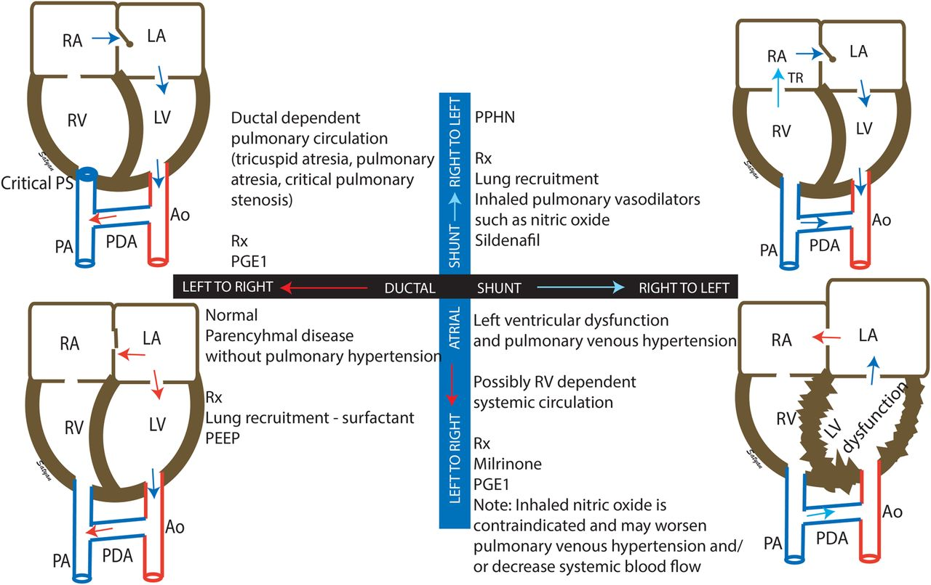
Goal Directed therapy in PPHN

Slide 19
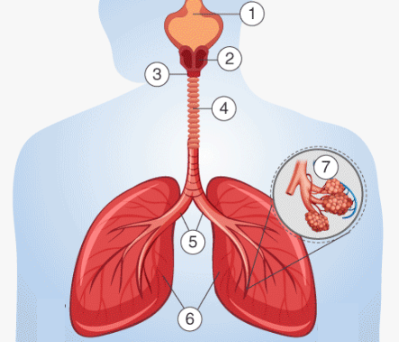
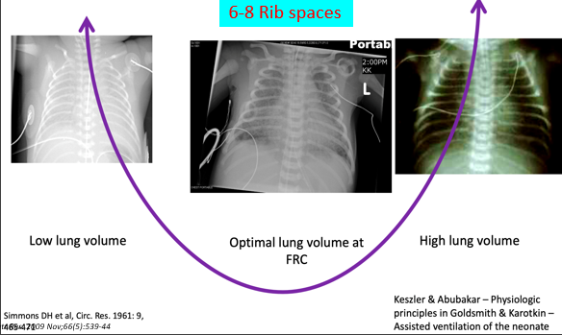
Optimising lung volume sine quo non of neonatal ventilation

Slide 20
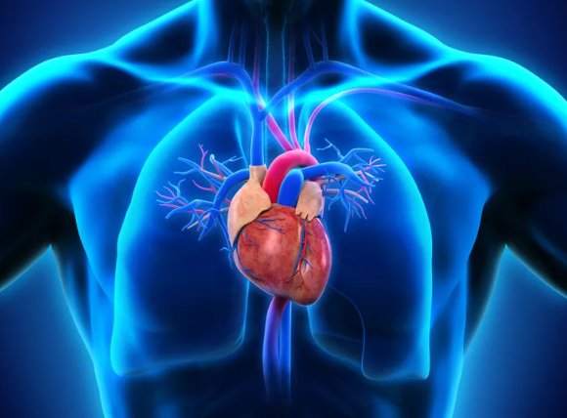
Cardiac Hemodynamics optimization

Slide 21
Functional Cardiac assessment
PAP | PVR | RV perfomance | Shunt | LV perfomance
1.TR peak velocity (SPAP) 2. PI peak velocity (DPAP) 3. Transductal RtL flow peak velocity (SPAP) 4. IVS configuration/LV-sEI | 5.RV systolic time intervals PAAT PAAT/RVET ratio RVPET/RVET ratio 6. TRV/VTI^{[RVOT]} ratio 7. Pulmonary artery compliance | 8. TAPSE 9. FAC 10. MPI 11. RV S/D ratio 12. TDI RV free wall & IVS 13. STE | 14. Transductal shunting Direction Peak flow velocity 15. Interatrial shunting Direction | 16.(LV-MPI), LV-SV and LVO, ejection fraction (EF biplane Simpson), 17.TDI of IVS and LV free wall 18.STE

Slide 22
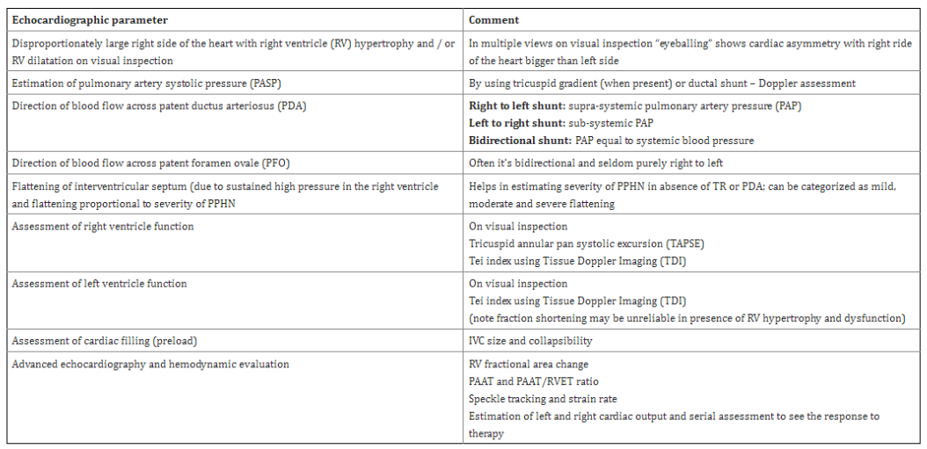

Slide 23
Physiology | Normal RV+LV function |  | RV dysfunction LV - normal |  | LV dysfunction ± RV dysfunction
Systemic blood pressure | Normal | Low | Normal | Low | Normal | Low
Pulmonary Vasodilator First tier Second tier | Sildenafil | iNO | Sildenafil /iNO Milrinone | iNO | Milrinone (avoid iNO) | Epinephrine Milrinone
 | iNO Bosentan | Sildenafil Bostentan | IV prostin Bosentan | Sildenafil Bostentan | Sildenafil Prostins – IV, SQ Bosentan | Prostins – inhaled (preferred) Bostentan
Systemic vasopressor | - | Norepinephrine Vasopressin | - | Epinephrine Norepinephrine Vasopressin | - | Epinephrine Hydrocortisone*
Inotropic agent | - | - | Milrinone | Epinephrine | Milrinone | Epinephrine

Slide 24
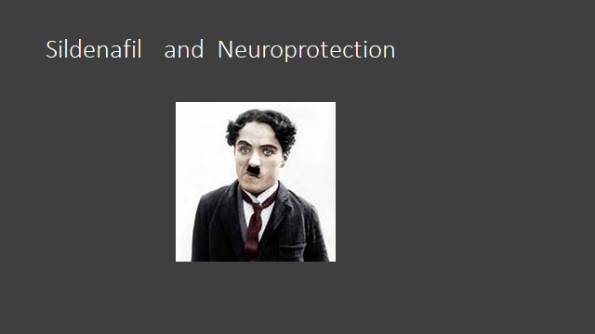

Slide 25
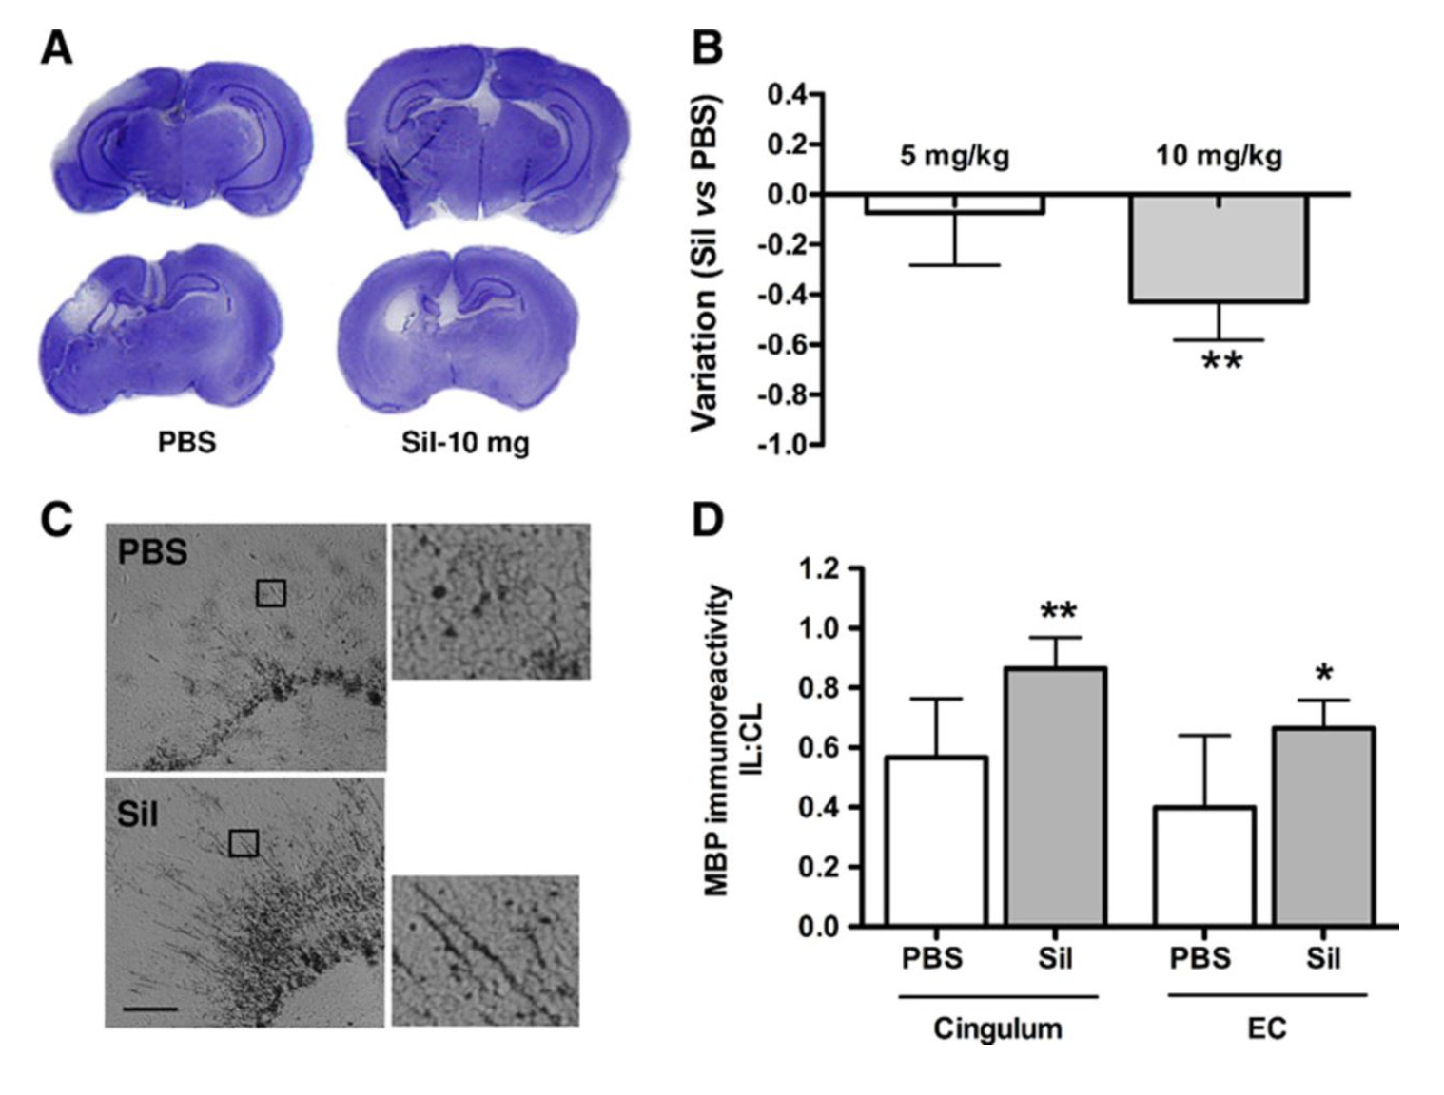
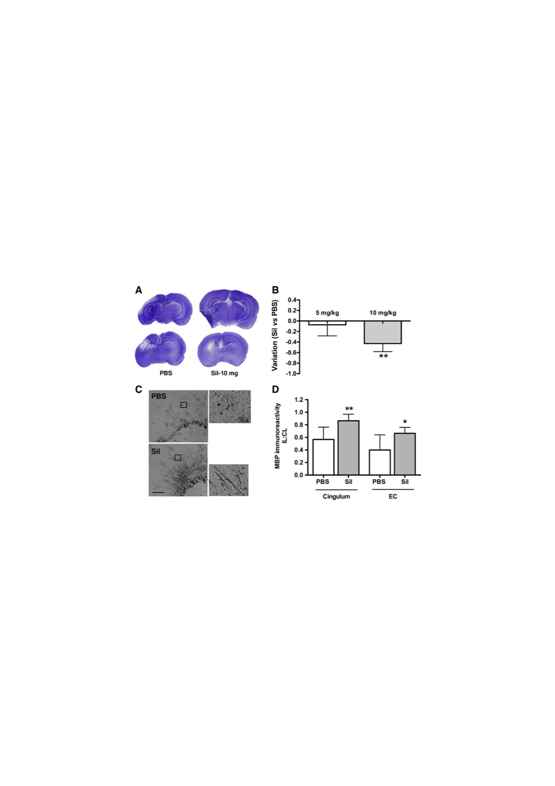
Sildenafil in Neuroprotection
Sildenafil Mediates Blood-Flow Redistribution and Neuroprotection After Neonatal Hypoxia-Ischemia
StrokeVolume 45, Issue 3, March 2014; Pages 850-856
Notes:
Effect of sildenafil on lesion size and myelinated fiber density 7 days after hypoxia-ischemia (HI). A, Representative cresyl-violet–stained sections at the level of the dorsal (upper) and ventral (lower) hippocampus in PBS-treated (n=12) and sildenafil-treated (Sil, n=12) animals. B, Variation in tissue loss 7 days after injury after treatment with 10 or 5 mg/kg sildenafil. C, Representative mouse antimyelin basic protein (MBP) immunolabeling in the cingulum and fragmentation of the myelin sheath in PBS and sildenafil-treated animals. EC: external capsule. Scale bars: 50 μm (20 μm in enlarged panels). D, Quantification of the optical density of MBP immunoreactivity expressed as the ratio of ipsilateral (IL) to contralateral (CL) labeling, (IL/CL)_{MBP}. *P<0.01, **P<0.001, sildenafil vs PBS treatment.

Slide 26
Efficacy of
Inhaled Nitric Oxide & Intragastric Sildenafil in Treatment of PPHN on High Frequency Oscillatory Ventilation
Dr. Rajiv Parapurath. MD.
Dr. Madan Samuel DM. MS. MCh.
Advances in Pediatric Research

Slide 27
PPHN
[84 neonates]
HFOV & Exogenous Surfactant
Diagnosis of PPHN
3-D-Echocardiography
PA/Sa Ratio > 1
Oxygenation Saturation Index
OSI 26 - 38
Persistent Hypoxia
SpO2 <90%: PaO₂ 49.5 to 58.5 mmHg: PaCO₂ ≥ 45 mmHg

Slide 28
PPHN
[84 neonates]
HFOV & Exogenous Surfactant
Disease Severity
iNO – 40-neonates
Intragastric Sildenafil – 44-neonates
SNAPPE-II Scores 72 (4)
OSI Scores 38 (5)
SNAPPE-II Scores 68 (3)
OSI Scores 36 (3)

Slide 29
RESPONSE
TO TREATMENT
Decline in OSI – 4-Hours
iNO – 40-neonates
Intragastric Sildenafil – 44-neonates
OSI Scores 17 (2)
OSI Scores 12 (1)
36-Hours: 81 neonates – OSI7.4 (1.2)

Slide 30
PRIMARY OUTCOMES
iNO – 40-neonates
Intragastric Sildenafil – 44-neonates
Mortality Rate – 8%
Failure Rate – 0%
Hypotension – 5%
Hypokalaemia – 3%
Pneumothorax – 5%
Anaemia – 15%
Bradycardia – 3%
Mortality Rate – 0%
Failure Rate – 27%
Hypotension – 18%
Hypokalaemia – 7%
Pneumothorax – 11%
Anaemia – 16%
Bradycardia – 5%
No Drug Withdrawal Syndrome

Slide 31
SECONDARY OUTCOMES
iNO – 40-neonates
Intragastric Sildenafil – 44-neonates
Encephalopathy – 3%
Cerebral Palsy – 8%
Epilepsy – 11%
Sensorineural Deficit – 5%
Encephalopathy – 0%
Cerebral Palsy – 0%
Epilepsy – 2%
Sensorineural Deficit – 2%
No Intraventricular Hemorrhage
3-D-Echocardiography Normal at Discharge. N=81.

Slide 32
Ventilatory Features
Hospital Stay and Outcomes
Characteristics | iNO (n=40) | iGS (n=44)
HFOV IN Hours | 68 (2) | 72 (2)
CMV post HFOV in Hours | 46 (1) | 42 (2)
CPAP in Hours | 54 (2) | 52 (3)
Duration of Pulmonary Vasodilators | 66 (2) | 72 (0)
NICU days | 28 | 31
Length of Stay in Days on NICU and SCBU | 48 | 52
Adverse Events [44%] | [12/40] 30% | [25/44] 57%
Treatment Failure Rate [14%] | 0% | [12/44] 27%
Mortality Rate [4%] | [3/40] 8% | 0%
Resolution of PPHN without Sequela [81%] | [25/37] 68% | [41/44] 93%
Resolution with Neurological Sequela [19%] | [12/37] 32% | [3/44] 7%

Slide 33
NEURODEVELOPMENTAL OUTCOMES
81 % NORMAL NEURODEVELOPMENT
19 % NEURODEVELOPMENTAL DELAY
Duration of Nitric oxide and Sildenafil did not impact on Neurodevelopmental Outcomes

Slide 34
NEURODEVELOPMENTAL DELAY [19%]
Mild Impairment (71 – 75) – 10%
iNO – 12-neonates
Intragastric Sildenafil – 3-neonates
Mild Impairment – 47%
Mild Impairment – 7%
Moderate to Severe Delay (57 – 62) – 9%
iNO – 12-neonates
Intragastric Sildenafil – 3-neonates
Mod to Severe Delay – 33%
Mod to Severe Delay – 13%
Mean Difference in Developmental Quotient Significant p=0.001

Slide 35
TREATMENT FLOW CHART
Severe PPHN
OSI 26-38. N=84
OSI 26-38. N=40
HFOV + ES + Inotropes
iNO (20 ppm) – 0-Hours
OSI 26-36. N=44
HFOV + ES + Inotropes
iGS (1mg/Kg/dose-q6H) – 0-Hours
OSI 36. N=12
iGS (1mg/Kg/q6H) – 0-Hour
iNO (20 ppm) + Milrinone
(0.6 mcg/Kg/min)-1-Hour
OSI ≤10. N=37+12
iNO (10 ppm) – 36-Hours
OSI ≤10.
iGS (1mg/Kg/q6H) – 72-Hours. N=44
iNO (10 ppm) – 36-Hours. N=12
iNO (N=12)
OSI ≤5
iGS (1mg/Kg/q8H) for 4 Days
OSI ≤5.
iNO (5 ppm) – 48-Hours
OSI ≤5.
iGS (1mg/Kg/q12H) for 4 Days
OSI ≤5.
iNO (5 ppm) – 60-Hours
Decrease iNO by 1 ppm every 30-minutes for 2-Hours
Discontinued 66-Hours
OSI ≤5
iGS (1mg/Kg/OD) for 4 Days
Discontinued 15th Day

Slide 36
CONCLUSIONS
Sildenafil
was as
efficacious as
Nitric Oxide
in this
specific population

Slide 37
CONCLUSIONS
Rebound Phenomenon did not occur as Sildenafil was gradually weaned
Similarly
iNO weaning should be gradual.

Slide 38
CONCLUSIONS
Neurodevelopmental Outcomes at age 2 years
Bayley III UK
Eighty-one percent of Children had Normal Neurodevelopment
Higher Incidence of Neurodevelopmental Delay in iNO Children

Slide 39
Protocol For PPHN in LMIC without INO
Expert Committee
Dr Rajiv P K
Dr Yogen Singh USA
Dr Augusto Sola USA
Dr Koert De Waal Australia
Dr Patrick Mc Namara USA
Dr Philip Levy USA

Slide 40
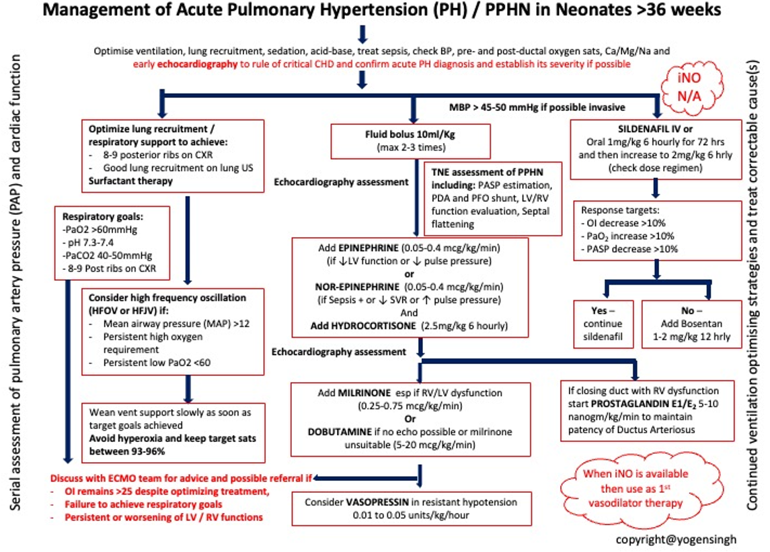

Slide 41
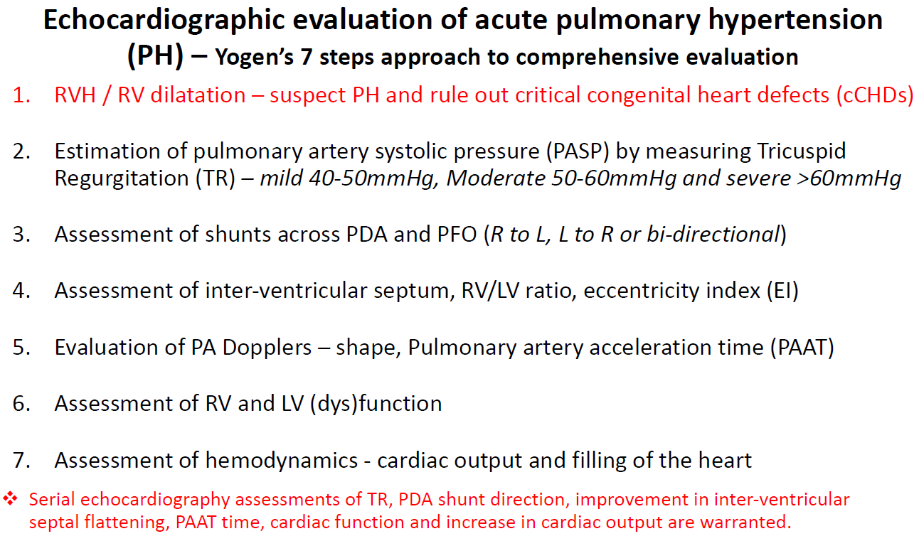

Slide 42
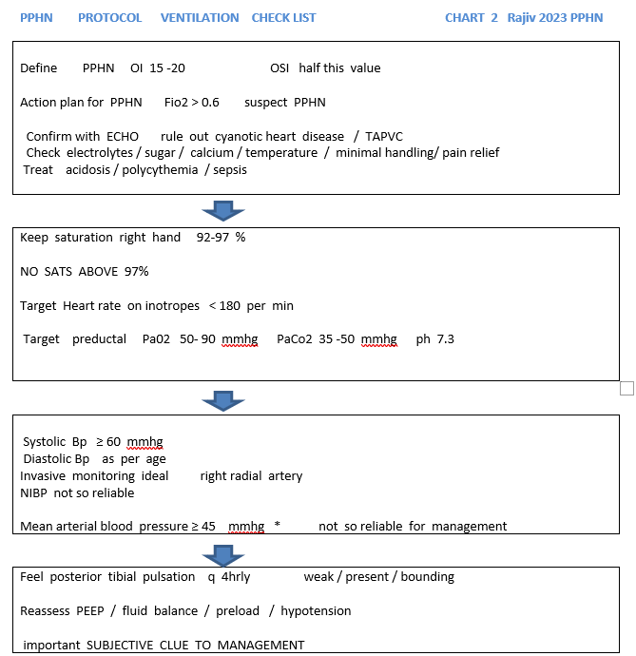

Slide 43
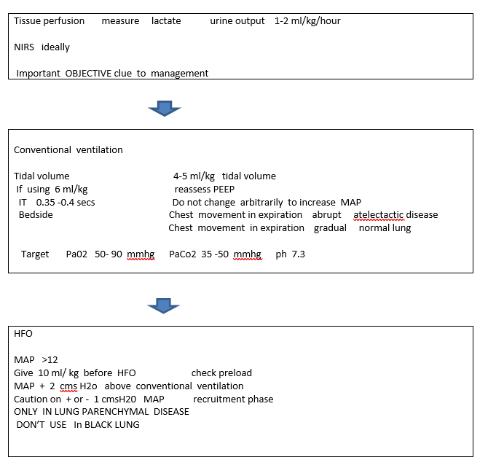

Slide 44
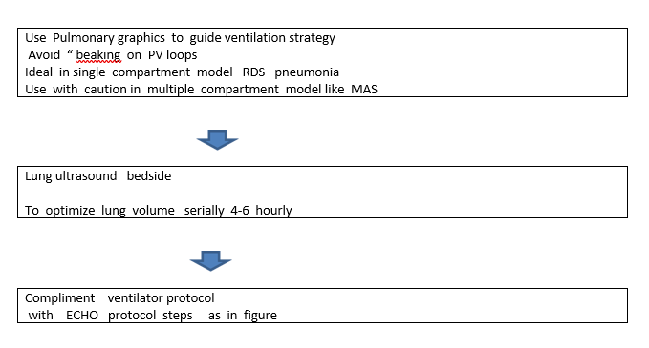

Slide 45
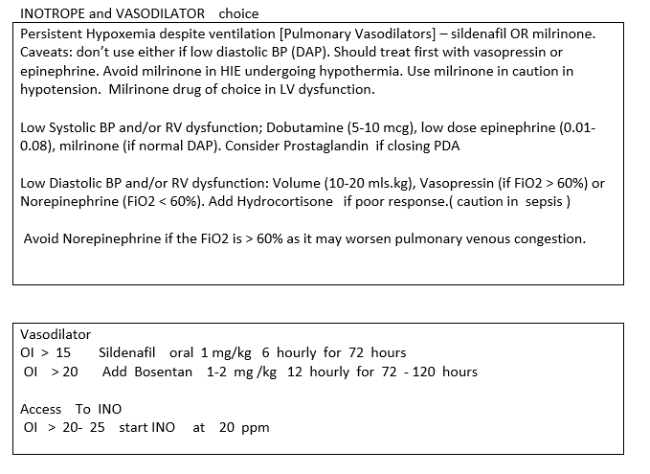

Slide 46
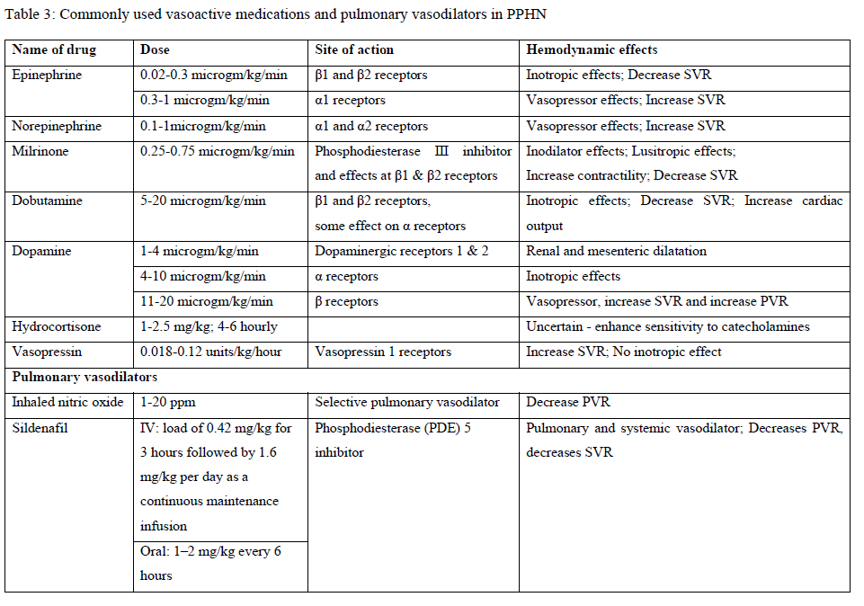

Slide 47

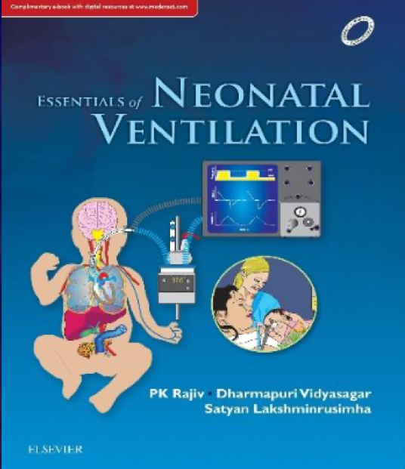

Thank you
Dr P K Rajiv

